Slide 1

SALARY SURVEY DATASET
Presented By:
K . Chandrika
Data Science & Analytics

Slide 2

Project Objective: The objective of this project is to analyze and interpret salary survey data using Excel & SQL. Excel for advanced data visualization and reporting data. SQL for data extraction, transformation, and basic analysis. Clean and structure the raw salary Survey dataset to ensure data integrity and consistency. Visualize findings using excel charts, pivot tables, and dashboards for easier interpretation by stakeholders.

Slide 3
Dataset Description:
The dataset contains 5,092 entries and 16 columns, including:
Demographics: Gender, Age Range, Country, State, City.
Compensation: Annual Salary, Additional Compensation, Currency.
Professional Info: Industry, Job Title, Years of Experience, Education Level.

Slide 4
Key Insights
The objective of this project is to analyze and interpret salary survey data using SQL for data extraction, transformation, and basic analysis, and Excel for advanced data visualization and reporting.
The project aims to : Clean and structure the raw salary dataset to ensure data integrity and consistency.
Extract key insights from the dataset using SQL queries, including average salary, median salary, distribution by job title, experience level, industry, and location.
Identify salary trends across various dimensions such as education level, gender, employment type, and geographic region.
Visualize findings using Excel charts, pivot tables, and dashboards for easier interpretation by stakeholders.

Slide 5
Data cleaning
Identify columns with missing data & to clean the dataset by handling missing values, standardizing data types, handling inconsistent values.
For numerical columns (like Annual Salary), either fill the missing values with the mean or median, or to remove rows with missing values.
For categorical columns (like Industry, Job Title), to replace missing values with a placeholder like "Unknown" or remove the rows.

Slide 6
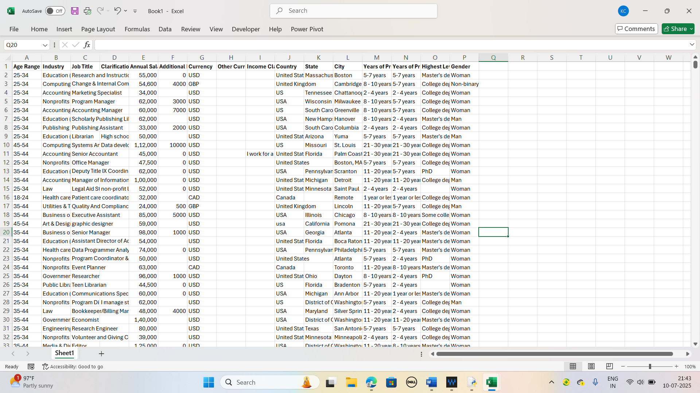
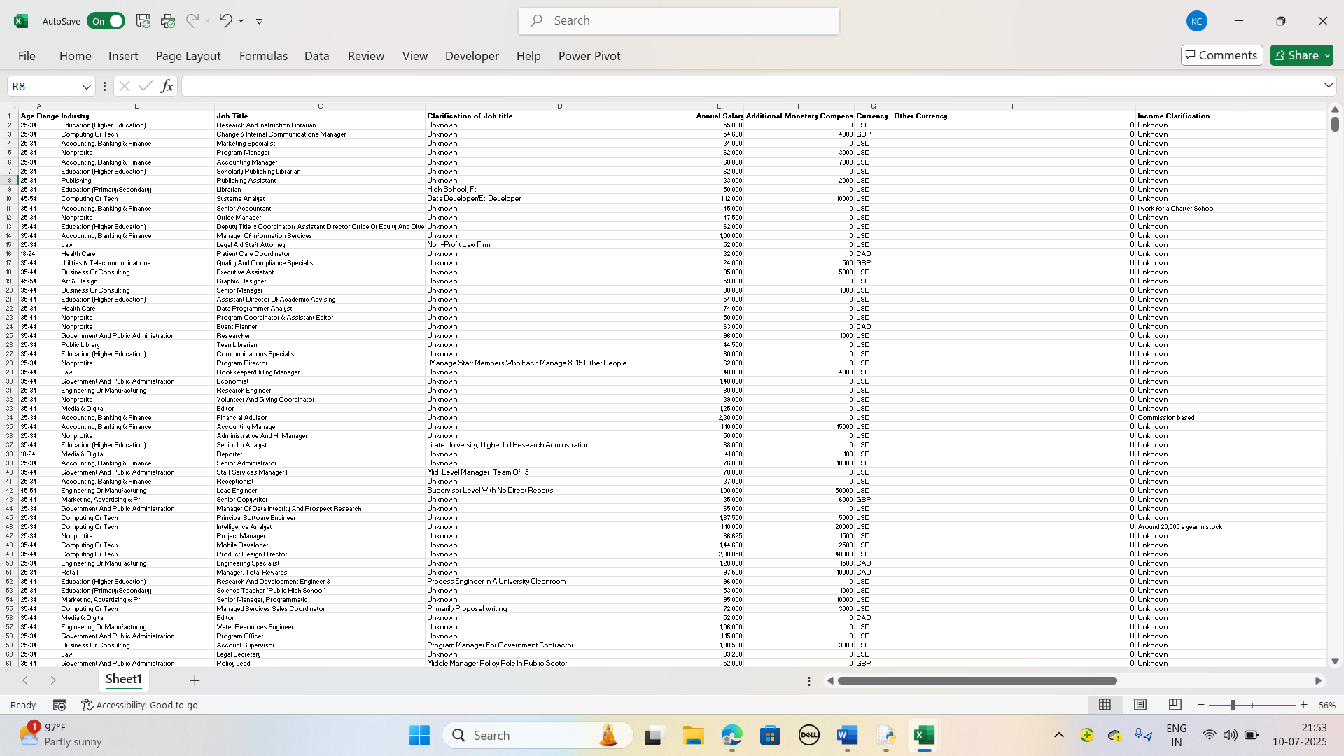
Row data
Clean data

Slide 7
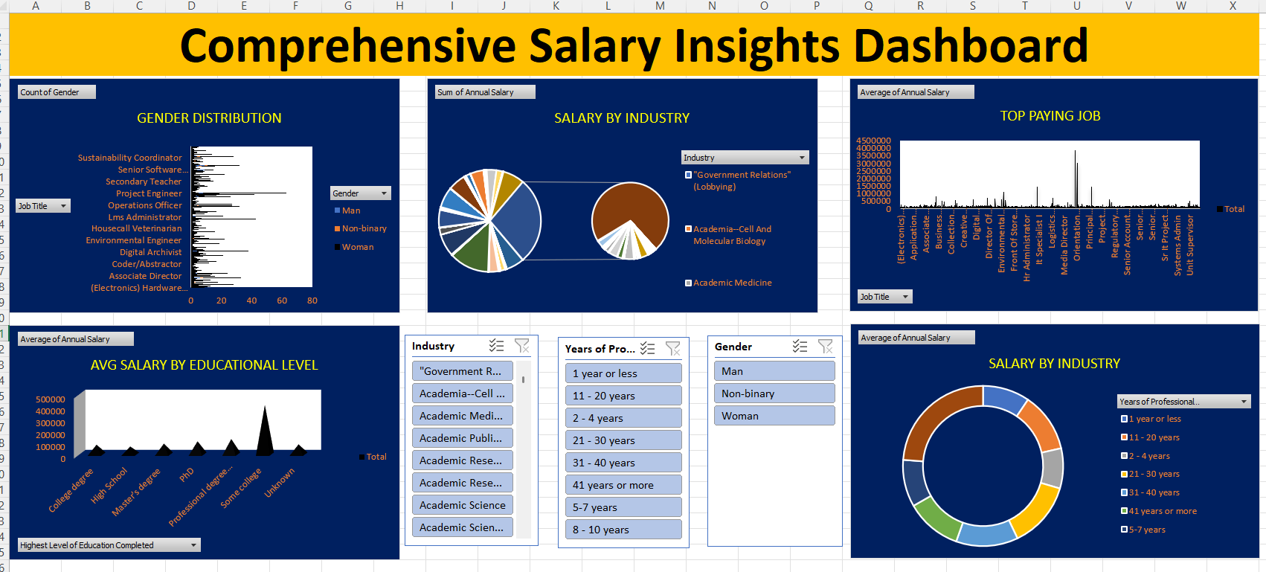
Dash Board

Slide 8
Gender Distribution
Bar chart displaying counts of Man, Woman, Non‑binary across different Job Titles.
Interactive Job Title and Gender slicers let you filter which roles or genders are shown.
Salary by Industry – Total Sum
Two pie charts:
A large one showing total payroll distribution across all industries
A focused smaller one (zoomed in) highlighting a selected industry (e.g., Academia – Cell And Molecular Biology)
Top Paying Job
A spike chart depicting the average annual salary for each job title.
Y-axis in rupees/dollars (values like 50,000 up to 4,500,000), showing which jobs pay the highest.
Avg Salary by Education Level
A bar or column chart that displays average annual salary for each education level: High School, College degree, Master’s, PhD, Professional degree, Some college, Unknown.
Salary by Industry – By Experience
A donut chart, breaking down average salaries by Years of Professional Experience (e.g., 1 year or less, 2–4 years, …, 41+ years), within the selected industry or filtered dataset.

Slide 9

Summary
A written summary of insights from the analysis, including documentation that outlines the project objective, dataset description, steps involved, screenshots of results obtained at each phase, insights derived from the analysis, and a conclusion for the project.

Slide 10
Thank you

